Slide 1
Dept. Of Physics GDC Rajouri
Laws of Thermodynamics
Presented by: Asif Ajaz Lone Asst. Professor of Physics

Slide 2
Thermodynamics
Thermodynamics is the study of the effects of work, heat, and energy on a system
Thermodynamics is only concerned with macroscopic (large-scale) changes and observations

Slide 3
Getting Started
All of thermodynamics can be expressed in terms of four quantities
Temperature (T)
Internal Energy (U)
Entropy (S)
Heat (Q)
These quantities will be defined as we progress through the lesson

Slide 4
Classical vs Statistical
Classical thermodynamics concerns the relationships between bulk properties of matter. Nothing is examined at the atomic or molecular level.
Statistical thermodynamics seeks to explain those bulk properties in terms of constituent atoms. The statistical part treats the aggregation of atoms, not the behavior of any individual atom

Slide 5
Introduction
According to British scientist C. P. Snow, the three laws of thermodynamics can be (humorously) summarized as
1. You can’t win
2. You can’t even break even
3. You can’t get out of the game

Slide 6
1.0 You can’t win (1st law)
The first law of thermodynamics is an extension of the law of conservation of energy
The change in internal energy of a system is equal to the heat added to the system minus the work done by the system
ΔU = Q - W

Slide 7
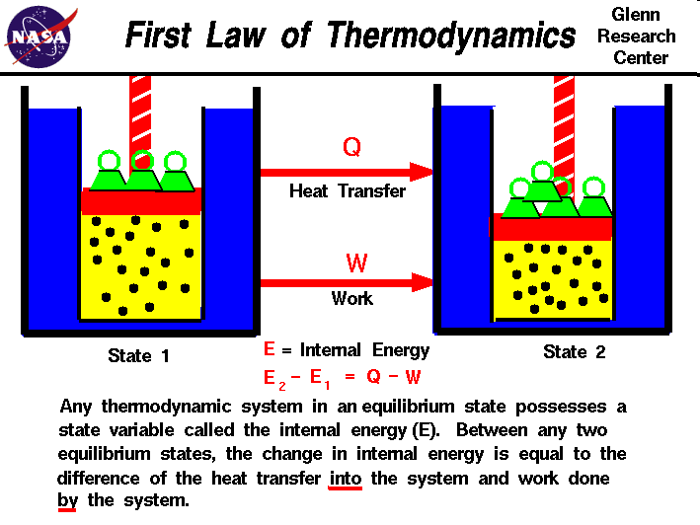
Slide courtesy of NASA

Slide 8
1.1 Process Terminology
Adiabatic – no heat transferred
Isothermal – constant temperature
Isobaric – constant pressure
Isochoric – constant volume

Slide 9
1.1.1 Adiabatic Process
An adiabatic process transfers no heat
therefore Q = 0
ΔU = Q – W
When a system expands adiabatically, W is positive (the system does work) so ΔU is negative.
When a system compresses adiabatically, W is negative (work is done on the system) so ΔU is positive.

Slide 10
1.1.2 Isothermal Process
An isothermal process is a constant temperature process. Any heat flow into or out of the system must be slow enough to maintain thermal equilibrium
For ideal gases, if ΔT is zero, ΔU = 0
Therefore, Q = W
Any energy entering the system (Q) must leave as work (W)

Slide 11
1.1.3 Isobaric Process
An isobaric process is a constant pressure process. ΔU, W, and Q are generally non-zero, but calculating the work done by an ideal gas is straightforward
W = P·ΔV
Water boiling in a saucepan is an example of an isobar process

Slide 12
1.1.4 Isochoric Process
An isochoric process is a constant volume process. When the volume of a system doesn’t change, it will do no work on its surroundings. W = 0
ΔU = Q
Heating gas in a closed container is an isochoric process

Slide 13
1.2 Heat Capacity
The amount of heat required to raise a certain mass of a material by a certain temperature is called heat capacity
Q = mc_{x}ΔT
The constant c_{x} is called the specific heat of substance x, (SI units of J/kg·K)

Slide 14
1.2.1 Heat Capacity of Ideal Gas
C_{V} = heat capacity at constant volume
C_{V} = 3/2 R
C_{P} = heat capacity at constant pressure
C_{P} = 5/2 R
For constant volume
Q = nC_{V}ΔT = ΔU
The universal gas constant R = 8.314 J/mol·K

Slide 15
2.0 You can’t break even (2nd Law)
Think about what it means to not “break even”. Every effort you put forth, no matter how efficient you are, will have a tiny bit of waste.
The 2nd Law can also be stated that heat flows spontaneously from a hot object to a cold object (spontaneously means without the assistance of external work)

Slide 16
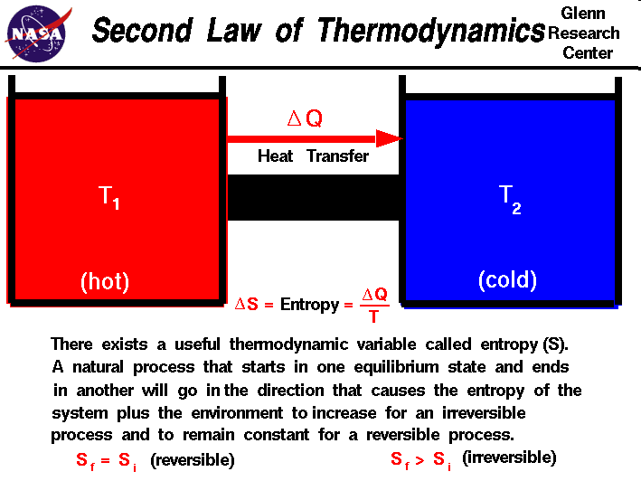
Slide courtesy of NASA

Slide 17
2.1 Concerning the 2nd Law
The second law of thermodynamics introduces the notion of entropy (S), a measure of system disorder (messiness)
U is the quantity of a system’s energy, S is the quality of a system’s energy.
Another C.P. Snow expression:
not knowing the 2nd law of thermodynamics is the cultural equivalent to never having read Shakespeare

Slide 18
2.2 Implications of the 2nd Law
Time marches on
If you watch a movie, how do you know that you are seeing events in the order they occurred?
If I drop a raw egg on the floor, it becomes extremely “disordered” (greater Entropy) – playing the movie in reverse would show pieces coming together to form a whole egg (decreasing Entropy) – highly unlikely!

Slide 19
2.3 Direction of a Process
The 2nd Law helps determine the preferred direction of a process
A reversible process is one which can change state and then return to the original state
This is an idealized condition – all real processes are irreversible

Slide 20
2.4 Heat Engine
A device which transforms heat into work is called a heat engine
This happens in a cyclic process
Heat engines require a hot reservoir to supply energy (Q_{H}) and a cold reservoir to take in the excess energy (Q_{C})
Q_{H} is defined as positive, Q_{C} is negative

Slide 21
2.4.1 Cycles
It is beyond the scope of this presentation, but here would be a good place to elaborate on:
Otto Cycle
Diesel Cycle
Carnot Cycle
Avoid all irreversible processes while adhering to the 2nd Law (isothermal and adiabatic only)

Slide 22
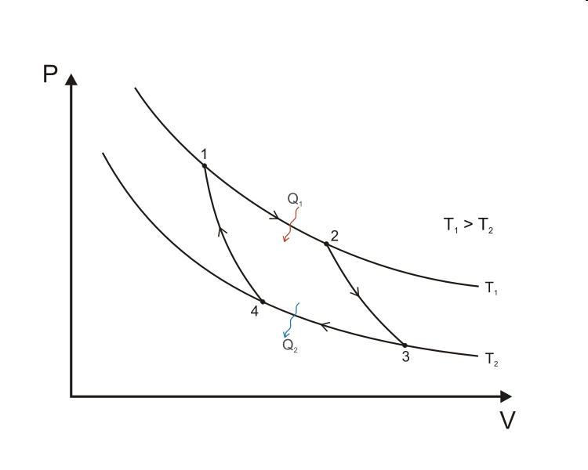
2.4.2 The Carnot Cycle
Image from Keta - Wikipedia

Slide 23
2.4.2.1 Carnot explained
Curve A (1 → 2): Isothermal expansion at T_{H}
Work done by the gas
Curve B (2 → 3): Adiabatic expansion
Work done by the gas
Curve C (3 → 4): Isothermal compression at T_{C}
Work done on the gas
Curve D (4 → 1): Adiabatic compression
Work done on the gas

Slide 24
2.4.2.2 Area under PV curve
The area under the PV curve represents the quantity of work done in a cycle
When the curve goes right to left, the work is negative
The area enclosed by the four curves represents the net work done by the engine in one cycle

Slide 25
2.5 Engine Efficiency
The thermal efficiency of a heat engine is
e = 1 + Q_{C}/Q_{H}
The “engine” statement of the 2nd Law:
it is impossible for any system to have an efficiency of 100% (e = 1) [Kelvin’s statement]
Another statement of the 2nd Law:
It is impossible for any process to have as its sole result the transfer of heat from a cooler object to a warmer object [Clausius’s statement]

Slide 26
2.6 Practical Uses
Automobile engines, refrigerators, and air conditioners all work on the principles laid out by the 2nd Law of Thermodynamics
Ever wonder why you can’t cool your kitchen in the hot summer by leaving the refrigerator door open?
Feel the air coming off the back - you heat the air outside to cool the air inside
See, you can’t break even!

Slide 27
3.0 You can’t get out (3rd Law)
No system can reach absolute zero
This is one reason we use the Kelvin temperature scale. Not only is the internal energy proportional to temperature, but you never have to worry about dividing by zero in an equation!
There is no formula associated with the 3rd Law of Thermodynamics

Slide 28
3.1 Implications of 3rd Law
MIT researchers achieved 450 picokelvin in 2003 (less than ½ of one billionth!)
Molecules near these temperatures have been called the fifth state of matter: Bose-Einstein Condensates
Awesome things like super-fluidity and super-conductivity happen at these temperatures
Exciting frontier of research

Slide 29
4.0 The Zeroth Law
The First and Second Laws were well entrenched when an additional Law was recognized (couldn’t renumber the 1st and 2nd Laws)
If objects A and B are each in thermal equilibrium with object C, then A and B are in thermal equilibrium with each other
Allows us to define temperature relative to an established standard

Slide 30
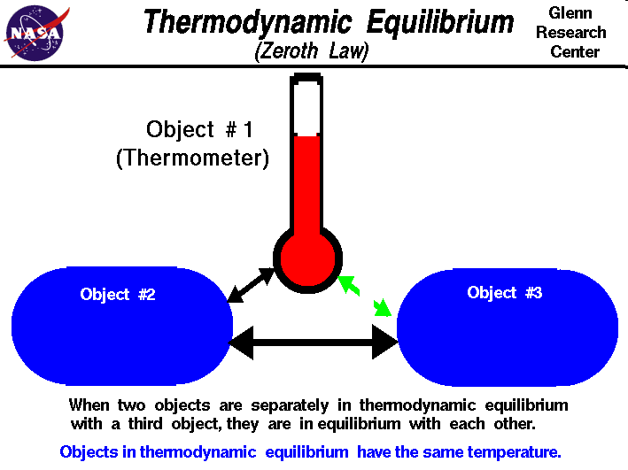
Slide courtesy of NASA

Slide 31
4.1 Temperature Standards
Thanks Asif Ajaz Lone
See Heat versus Temperature slides for a discussion of these two concepts, and the misconceptions surrounding them
Heat is energy transfer
Temperature is proportional to internal energy
Fahrenheit, Celsius, and Kelvin temp scales

